Slide 1
Sarcasm Detection

Slide 2
Content
Introduction
Problem Statement
Exploratory Data Analysis
Text Preprocessing
Model Architecture
Results
Conclusion

Slide 3
INTRODUCTION
Sarcasm has been a part of the human language for a very long time. It means to say the opposite of what you really mean, usually in a mocking or humorous way.
However, understanding sarcasm can vary from person to person as it depends on an individual's mindset and perception.
So, the question is - can computers be trained to detect sarcasm?

Slide 4
Problem Statement
In this project, I trained a Deep Learning model to detect whether the text is sarcastic or not.
I've taken a dataset from Kaggle that consist of news headlines. It has 3 features: article_link, headline and a binary target label, is_sarcastic.
This project also requires using Natural Language Processing (NLP) since we have to make the text machine-readable.
SARCASM DETECTION

Slide 5
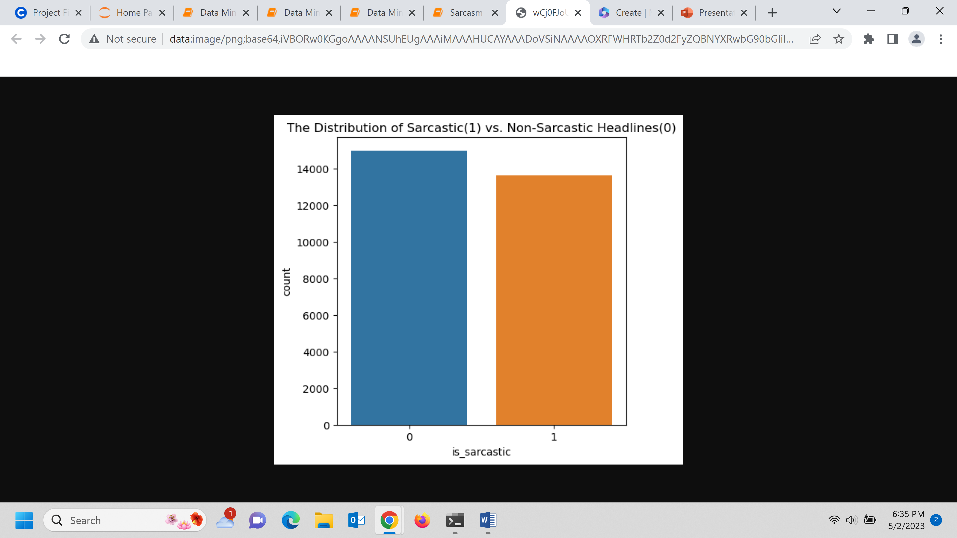
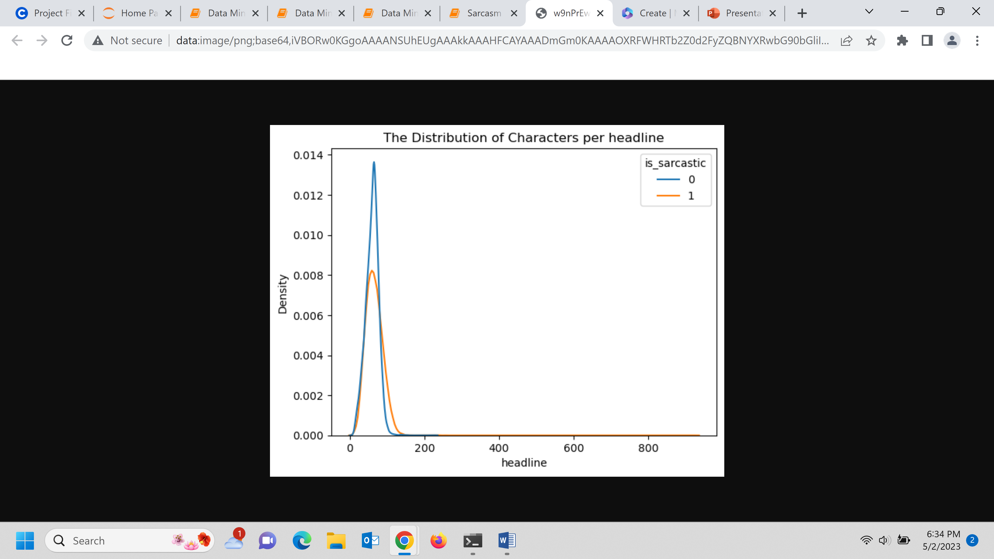
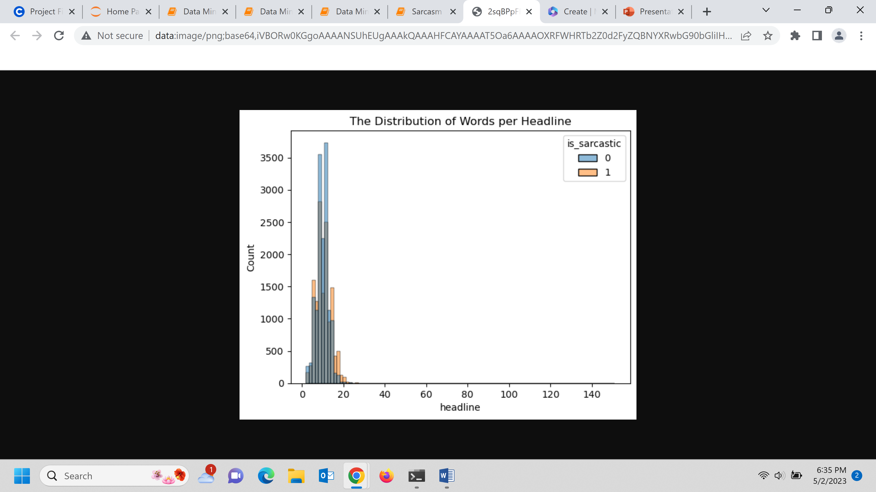
Brief Exploratory Data analysis

Slide 6
Text Preprocessing
We need to preprocess text so that it can be understood by the deep learning model.
The following NLP techniques were used:
Lowercasing the text
Removing punctuation, numeric and special characters
Removing stop words
Tokenization and Lemmatization

Slide 7
Model Architecture
Recurrent Neural Networks are very useful for evaluating sequences. The hidden layers can learn earlier parts of the sequence from previous runs of the neural network.
RNNs are good algorithms for text classification as text is sequential information.
We need to transform the preprocessed text into real-value vectors known as word embeddings.
For the first model, I created my own word embeddings by using the Embedding Layer provided by Keras.
The embedding layer is followed by two stacked Bidirectional LSTMs, a dense Layer, a dropout layer and finally, another dense layer

Slide 8
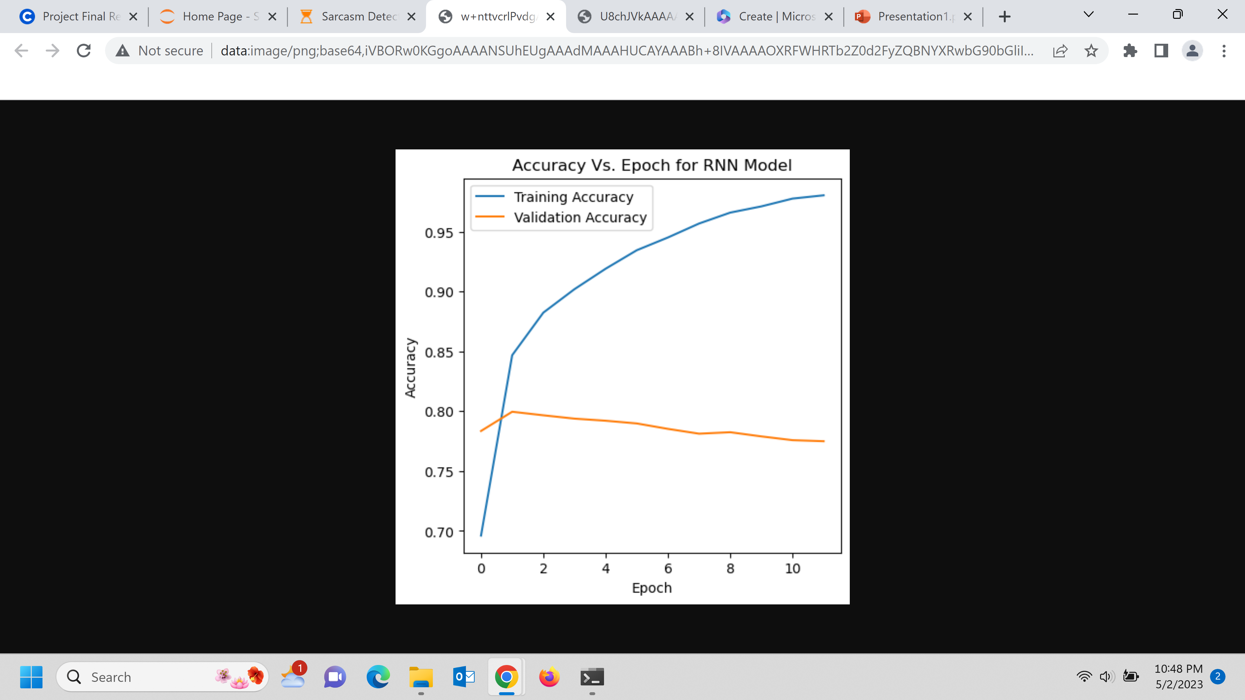
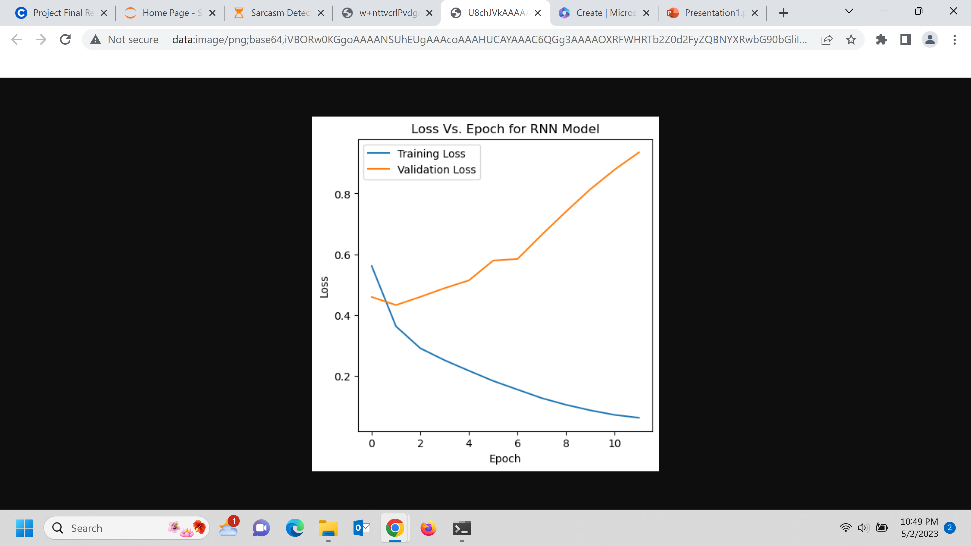
First Model Results
The model accuracy is 77.5%
Precision is 78.14%
Recall is 74.36%
Can this model be improved further?

Slide 9
Second Model Architecture
I've used GloVe which is pre-trained word embeddings developed by Stanford Researchers.
After preparing an embedding matrix, it is used in the embedding layer
The rest of the architecture is like the first model.

Slide 10
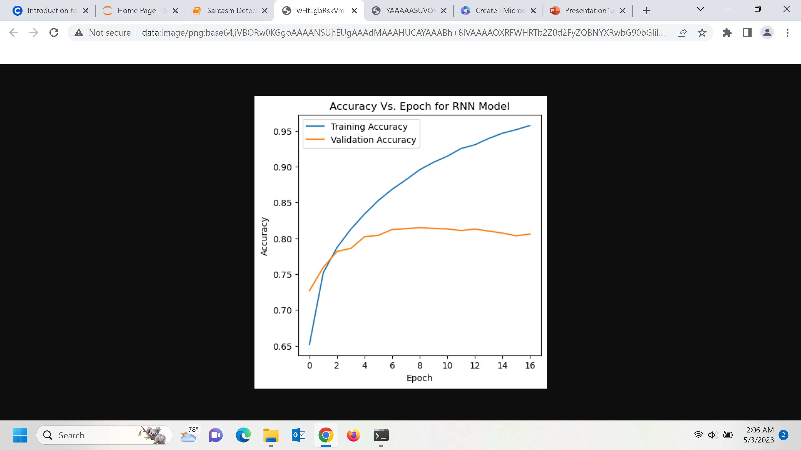
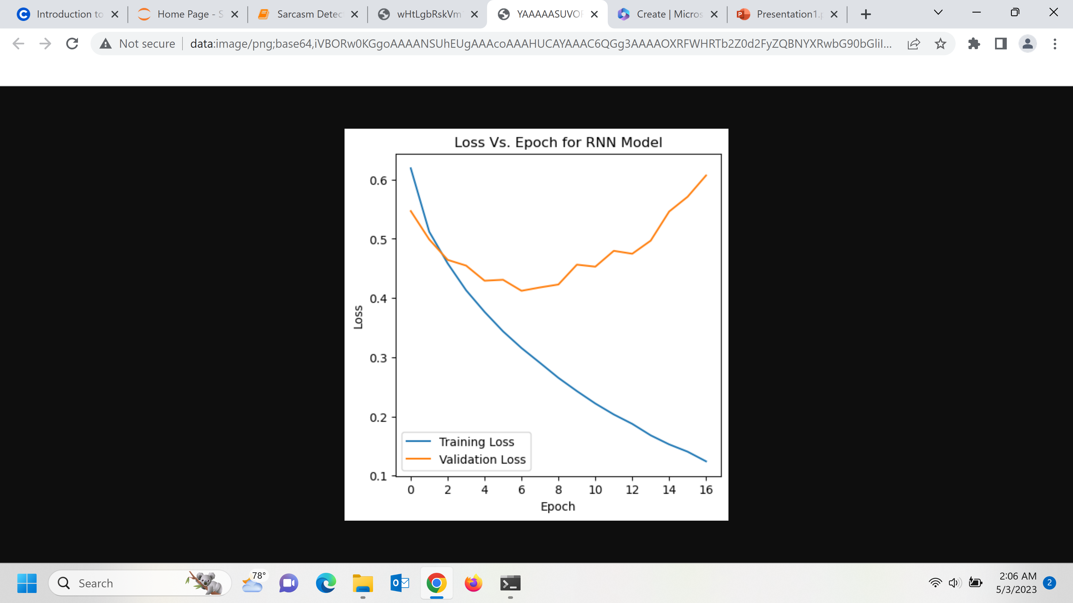
Second Model Results
The model accuracy is 80.6%
Precision is 80.55%
Recall is 79.01%

Slide 11
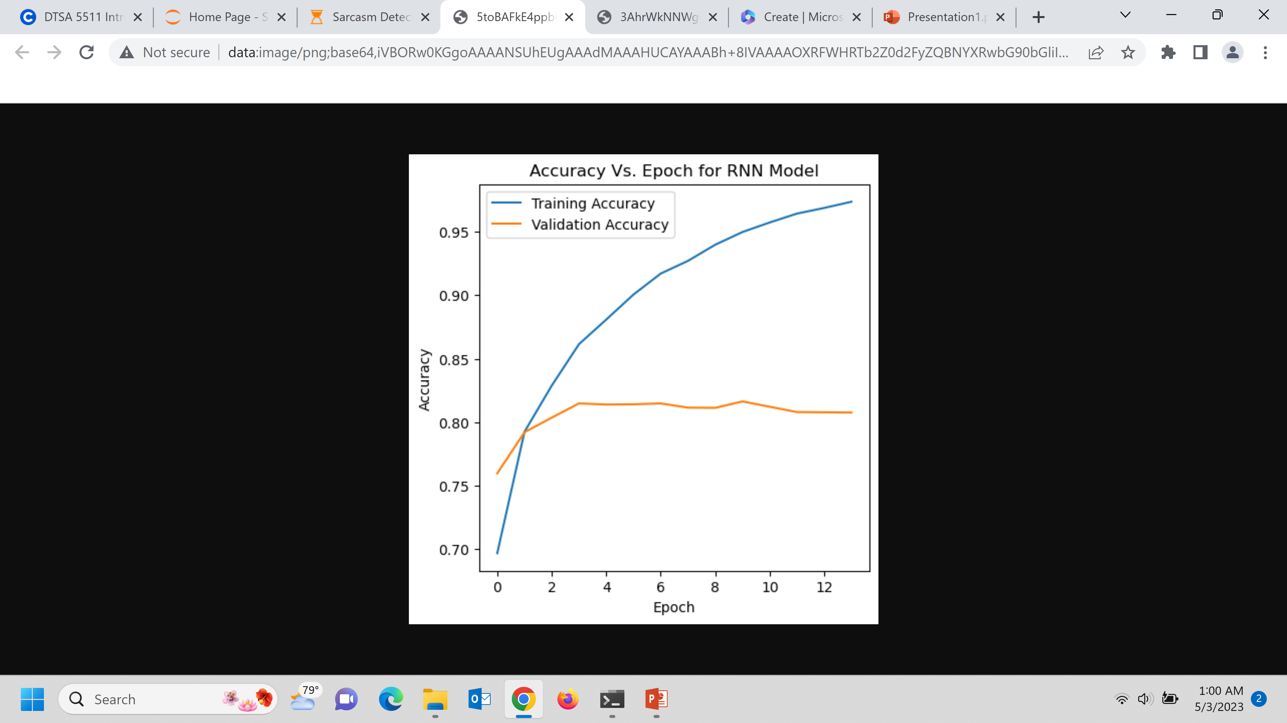
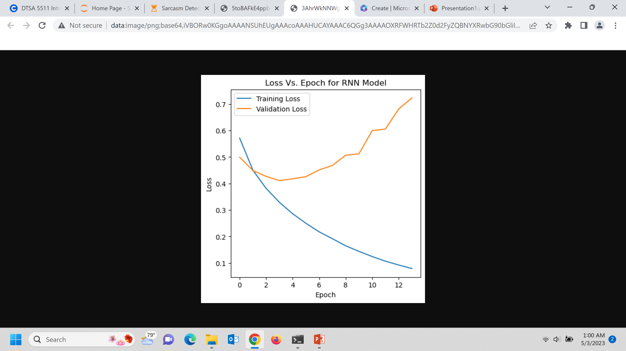
Hyperparameter tuning results
Best Learning rate: 2e-4
Best Dropout rate = 0.2
Dense layer units = 64
Accuracy is 80.77%
Precision is 81.52%
Recall is 77.97%

Slide 12
Conclusion
In this project, we trained an RNN model to detect the use of sarcasm in news headlines.
Using pre-trained word embeddings improved model performance
After hyperparameter tuning, the best learning rate was 2e-4. Allowing the embedding layer to update weights during training also improved the performance.
In future work, I would like to use other text datasets such as tweets.

Slide 13
THANK YOU

